Slide 1
NITHIN M KANNAL
Ramaiah Institute of Technology
Employment

Slide 2
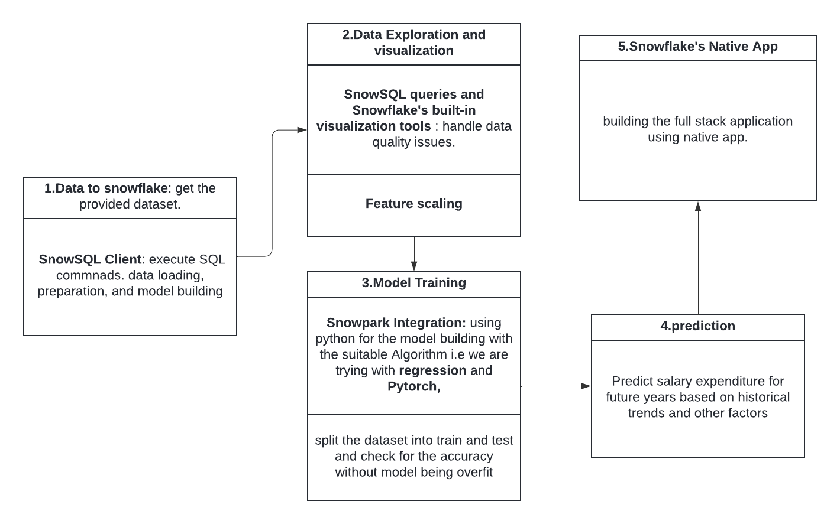
Problem
Architecture Flow
Problem Statement: Indian corporate earning, expenditure and contribution to government schemes.
Theme: Employment
Hypothesis
Technologies Used
Predict salary expenditure for future years: this is important because Understanding the spending and investing of corporate people in a country helps the marketing to target the specific domain and rise their business.
Languages and Libraries: Snowpark for Python, Scikit-learn, DataRobot, numpy, pandas, seaborn, matplotlib.
Snowflake: https://www.snowflake.com/en/ Cloud-based data platform for storage, processing, and analysis.
Snowpark: for python in snowflake
Cite data used: https://data.gov.in/resource/salary-expenditure-percentageage-revenue-expenditure-net-ip-pension-states-uts-2007-08

Slide 3
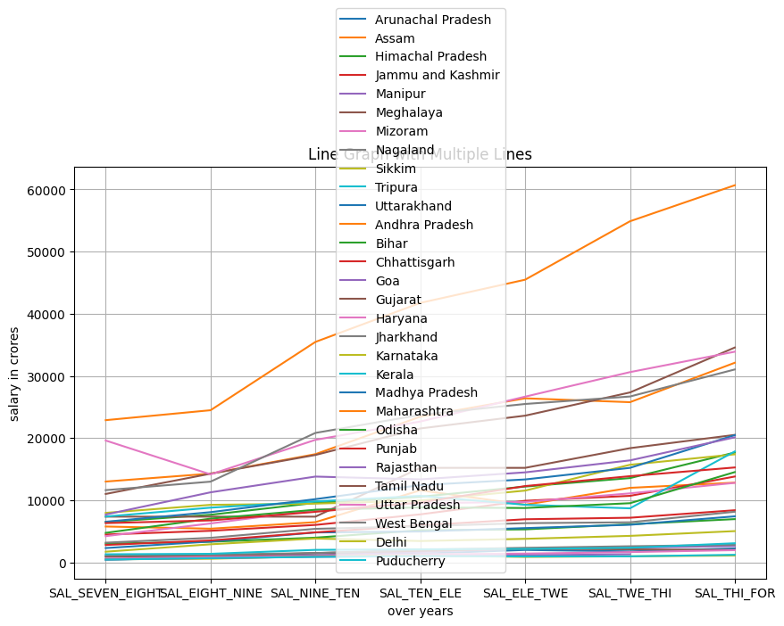
Insight and Recommendations #1
Insight
Salary expenditure visualization
Maharashtra has the highest salary expenditure over years.
Special Category, Union territories have the least over years.
As least and highest difference is huge it seems dimensionality reduction is needed.
Recommendation
Recommendation for state agencies that would help all SCS and Union territories is to improve job opportunities and salary.
Market sector can target the states above some threshold and make profit.

Slide 4
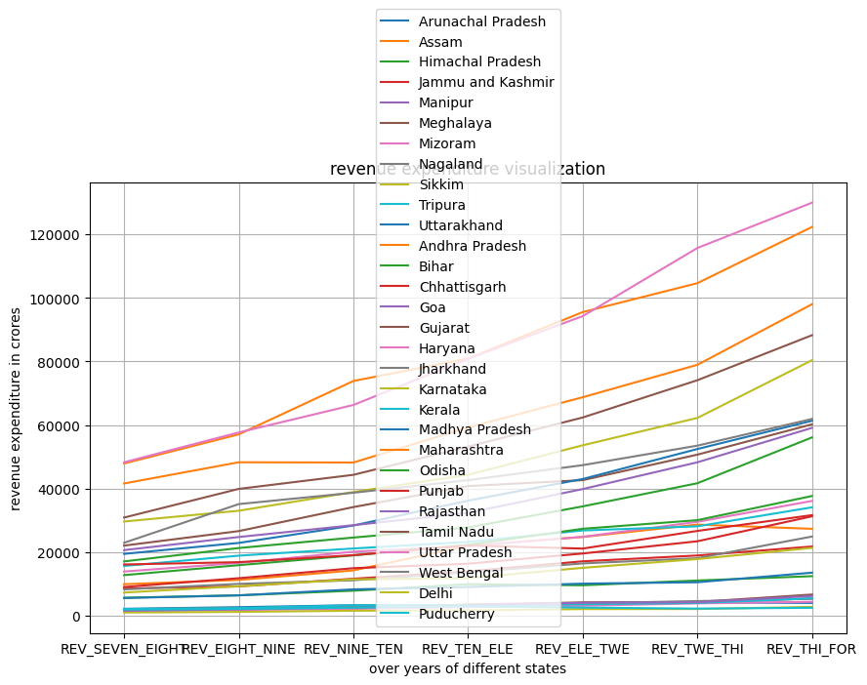
Insight and Recommendations #2
Revenue expenditure of different states
Insight
Bihar is the most growing state in the revenue that has to me concentrated.
Andhra pradesh has the most revenue paying once.
Take threshold for predicting the next years of revenue
Recommendation
States which are above let's consider 30000 crores has more revenue expenditure that could be used to build tourist places and attract to get more revenue out of it.
The descent salary and most revenue paying states has to concentrated

Slide 5
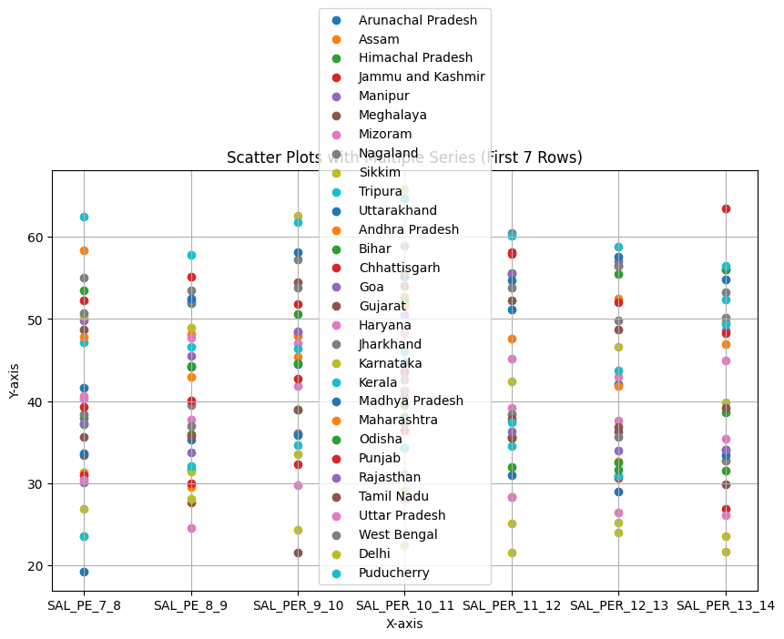
Insight and Recommendations #3
Insight
Salary Expenditure As Percentage of Revenue Expenditure
We saw tripura no where in highest salary but this insight shows the revenue with respect to salary is high.
Delhi has the lowest percentage.
Uttarakhand has the more growth
Recommendation
Government to invest on tourist and other attractive places to get the revenue from states.
Target the states who spend more for business and commercial profit.

Slide 6
THANK YOU

